Slide 1
Chapter 23
Finding the Electric Field - II
In this chapter we will introduce the following new concepts:
The flux (symbol Φ ) of the electric field. Symmetry Gauss’ law
We will then apply Gauss’ law and determine the electric field generated by: An infinite, uniformly charged insulating plane. An infinite, uniformly charged insulating rod. A uniformly charged spherical shell. A uniform spherical charge distribution.
We will also apply Gauss’ law to determine the electric field inside and outside charged conductors.
(23-1)

Slide 2
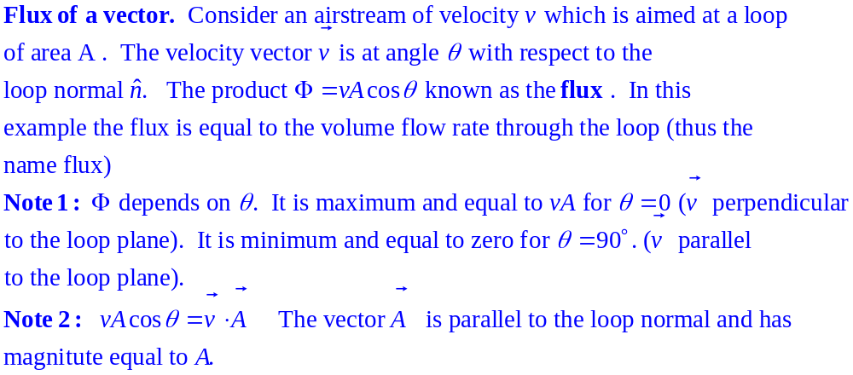
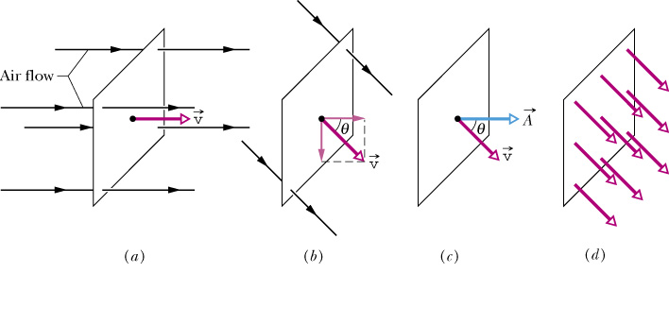

(23-2)

Slide 3
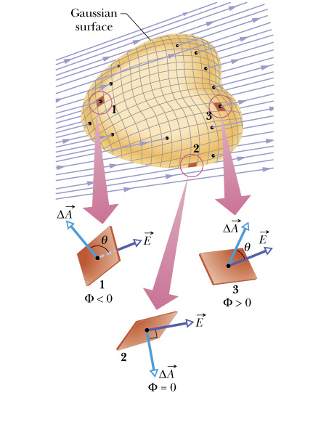
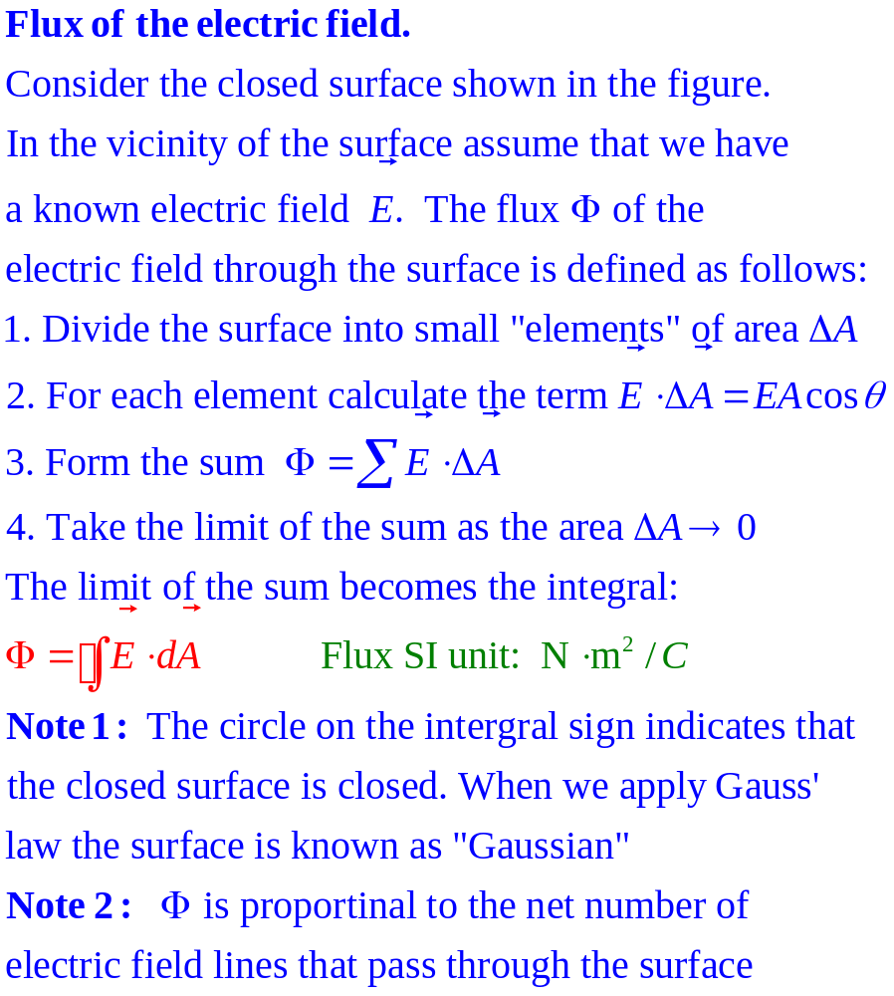
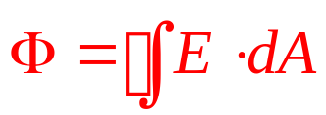
(23-3)

Slide 4
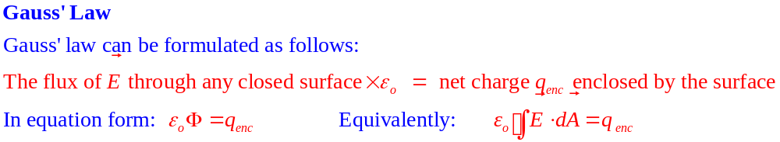
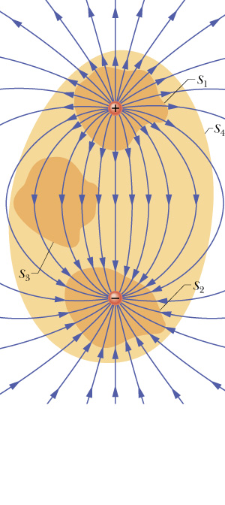
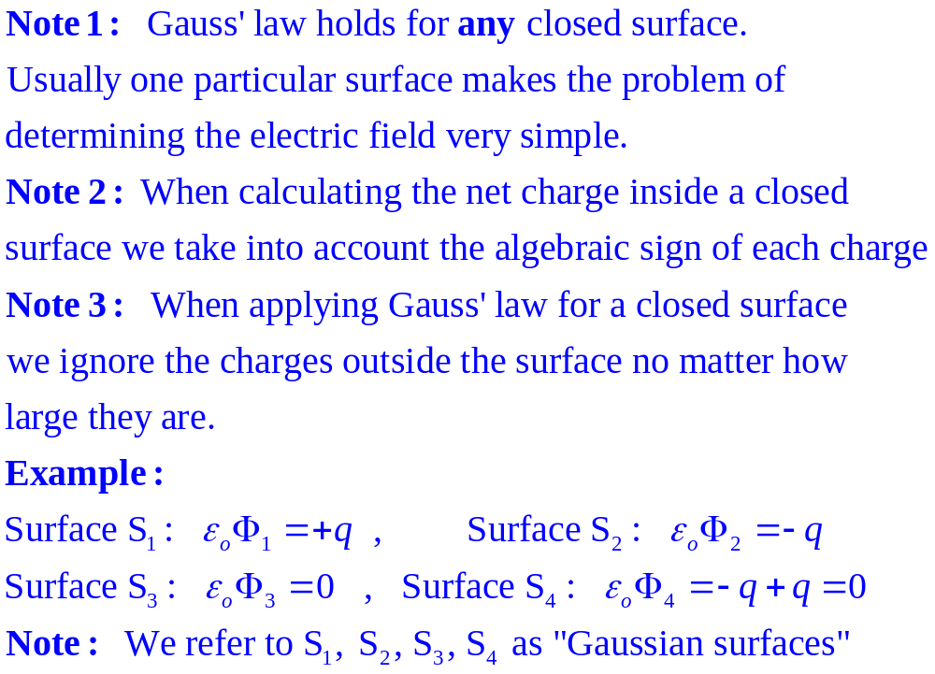


(23-4)

Slide 5
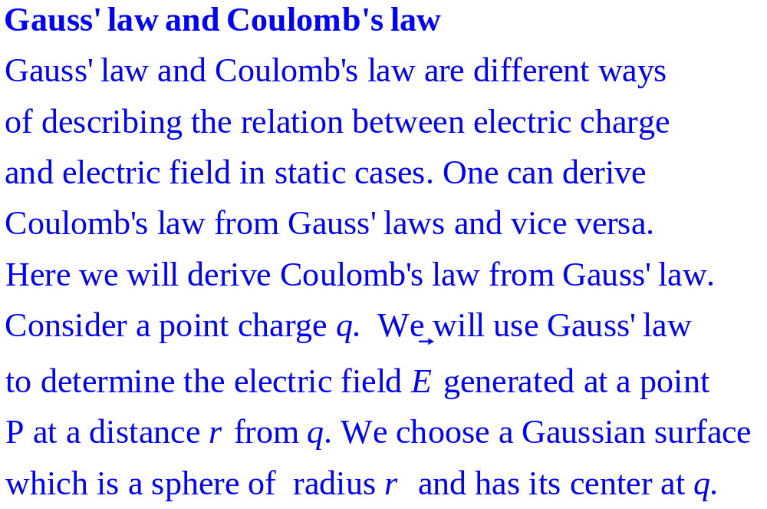
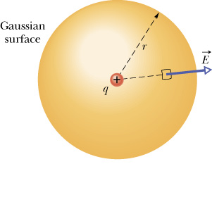
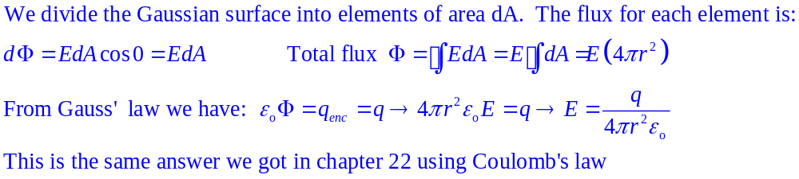
dA
(23-5)

Slide 6
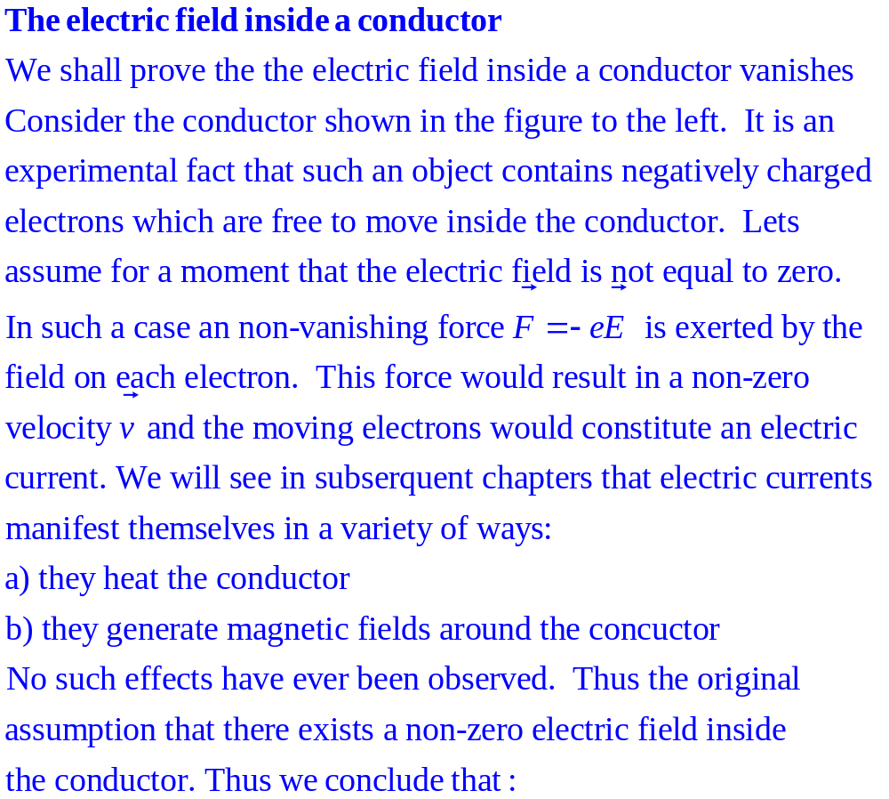



(23-6)
e

Slide 7
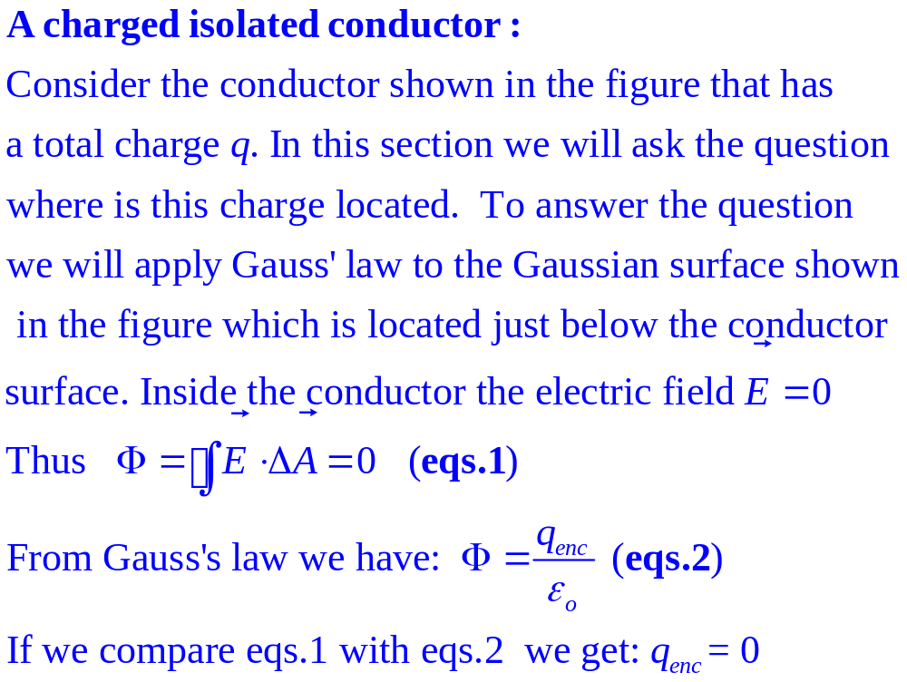
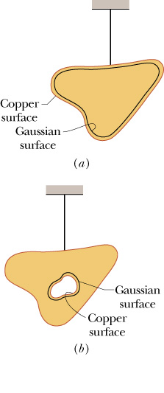
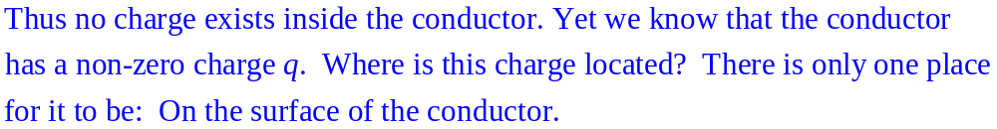
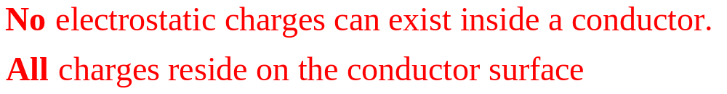
(23-7)

Slide 8
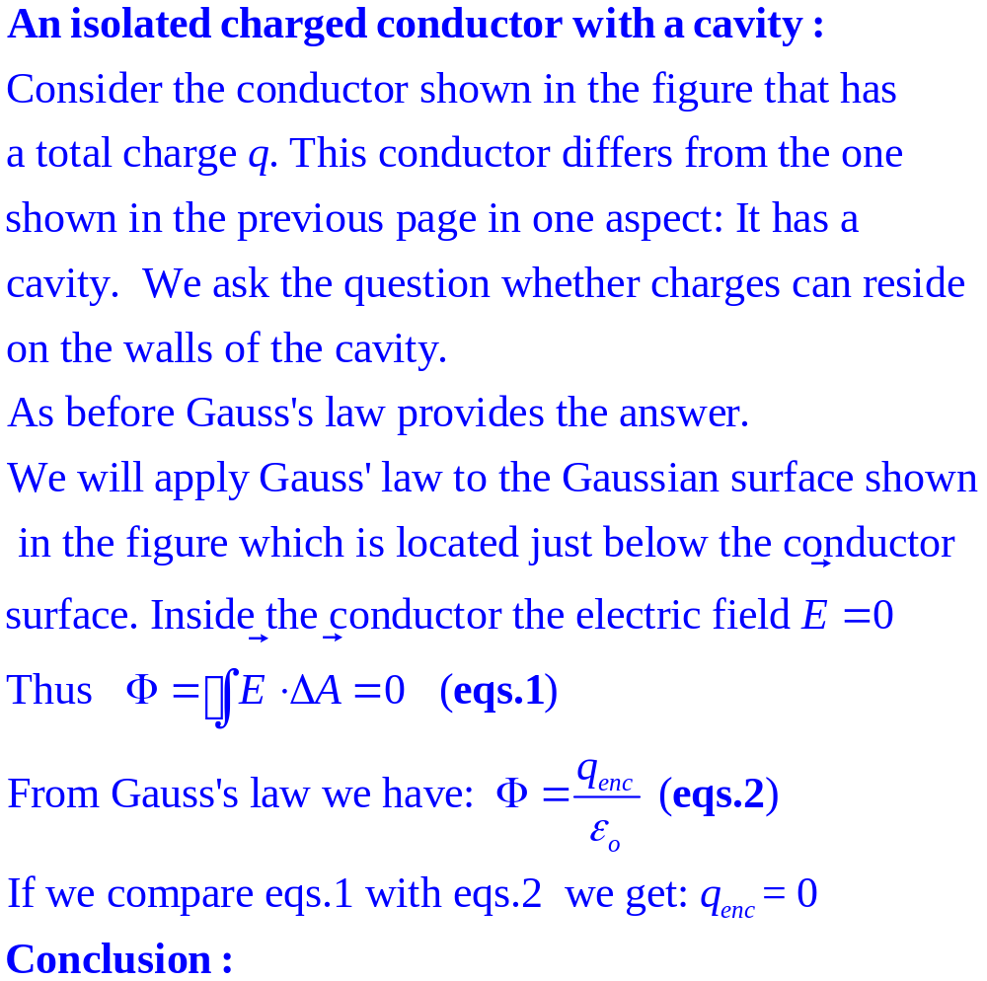
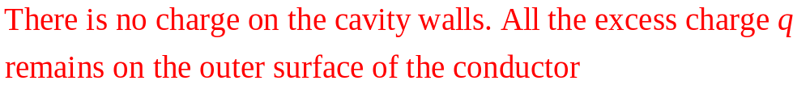
(23-8)

Slide 9
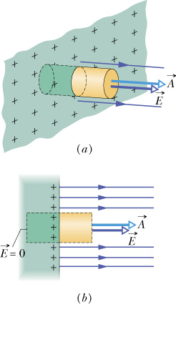

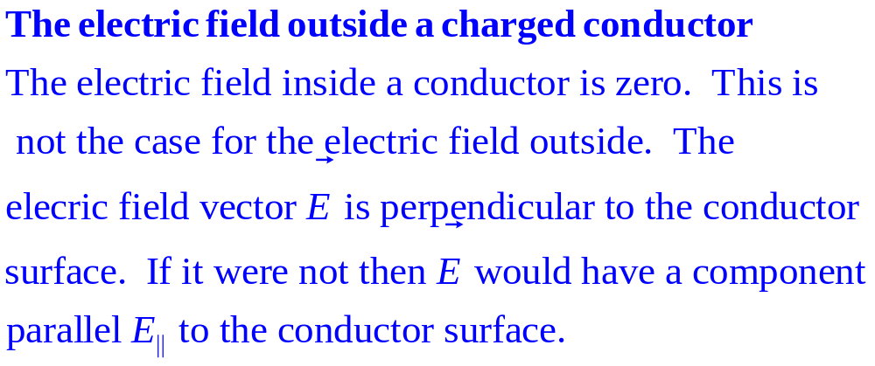


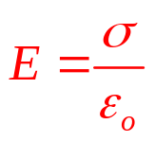
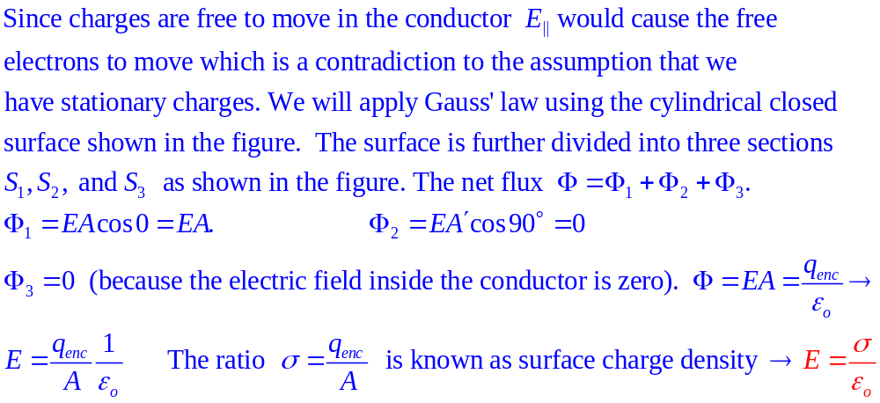
S₃
S₂
S₁
(23-9)

Slide 10
Symmetry: We say that an object is symmetric under a particular mathematical operation (e.g. rotation, translation, …) if to an observer the object looks the same before and after the operation. Note: Symmetry is a primitive notion and as such is very powerful
Example of spherical symmetry
Consider a featureless beach ball that can be rotated about a vertical axis that passes through its center. The observer closes his eyes and we rotate the sphere. Then, when the observer opens his eyes, he cannot tell whether the sphere has been rotated or not. We conclude that the sphere has rotational symmetry about the rotation axis.
Rotational symmetry
observer
featureless sphere
rotation axis
(23-10)

Slide 11
Rotational symmetry
A second example of rotational symmetry
Consider a featureless cylinder that can rotate about its central axis as shown in the figure. The observer closes his eyes and we rotate the cylinder. Then, when he opens his eyes, he cannot tell whether the cylinder has been rotated or not. We conclude that the cylinder has rotational symmetry about the rotation axis
Featureless cylinder
rotation axis
observer
(23-11)

Slide 12
Example of translational symmetry:
Consider an infinite featureless plane. An observer takes a trip on a magic carpet that flies above the plane. The observer closes his eyes and we move the carpet around. When he opens his eyes the observer cannot tell whether he has moved or not. We conclude that the plane has translational symmetry
Translational symmetry
observer
magic carpet
infinite featureless plane
(23-12)

